Slide 1
Design and drawing for production
Unit 7 – Introduction to SketchUp
Section 1 – Introduction to SketchUp

Slide 2
The big idea
What is CAD
SketchUp and how to get it
Purpose of 3D modeling
TinkerCAD and SketchUp

Slide 3
What is CAD?
CAD stands for Computer-Aided-Design
The use of computer systems or applications to create, modify, analyze, and prototype
Largely used to improve communication and productivity of the designer
Used through various industries
Automotive
Shipbuilding
Aerospace
Architectural
Prosthetics

Slide 7
TinkerCAD vs. sketchup
Freeware
Both applications are free to signup and use
Probably the two best applications available today
TinkerCAD developed by AutoDesk
Autodesk, Inc. is an American multinational software corporation that makes software services for the architecture, engineering, construction, manufacturing, media, and entertainment industries
SketchUp developed by Trimble
Previously was owned by Google
Trimble is a mapping, surveying and navigation equipment company

Slide 8
Why TinkerCAD
Pros
Extremely easy interface is child-friendly. Great for introduction to CAD or elementary to high school education
Web-based, no downloads required
Cons
Limited functionality or ability to customize – serious designers will outgrow quickly
Somewhat slow during US school hours due to popularity among educators

Slide 9
Why sketchup
Pros
Interface is extremely intuitive – ideal for beginner learning
100,000+ pre-made models available in 3D Warehouse
Creating documentation and layouts (title blocks)
Cons
Limited simulation or advanced tools functionality
Very limited functionality for designing custom parts, most custom designs will require repair

Slide 10
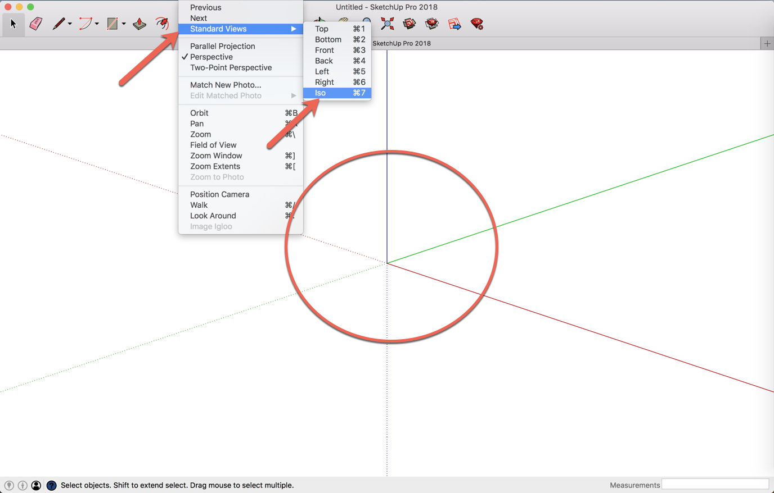
When opening SketchUp select any template to work with, this can be changed at anytime
TIP: Use a template with inches and feet
Change the view to ISO to get a more 3D perspective
REMINDER: Your default view is zoomed far out

Slide 11
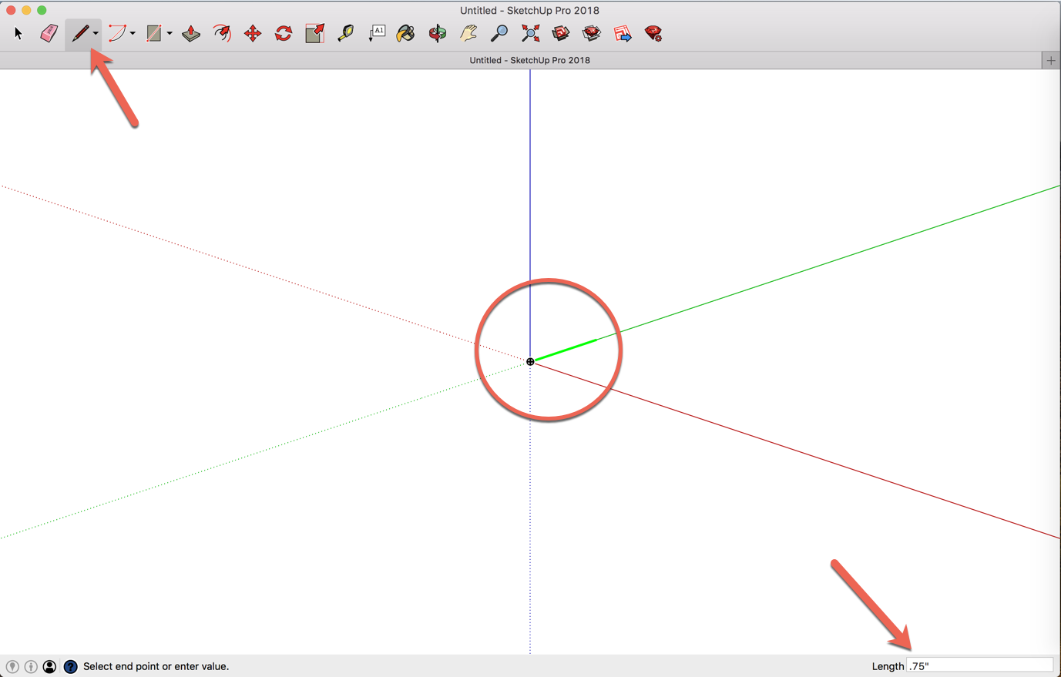
Select the PEN tool that will allow you to draw lines
Click on the center point of the axis to draw a line on the green axis
After clicking draw your mouse and then begin typing .75”
Press enter
REMINDER: Your default view is zoomed far out

Slide 12
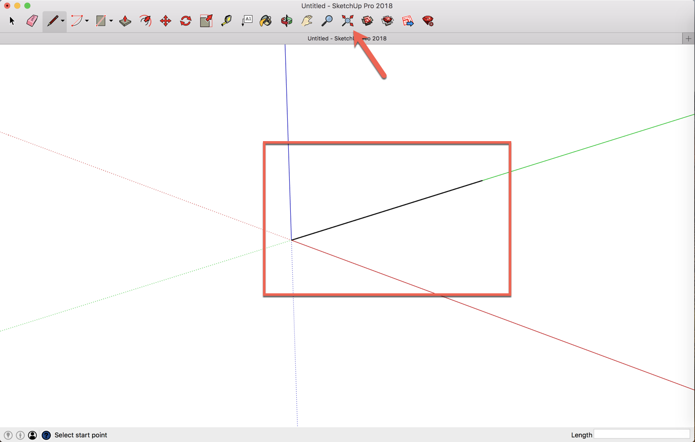
Once your line is created use the zoom extents option to bring everything into view
REMINDER: Your default view is zoomed far out

Slide 13
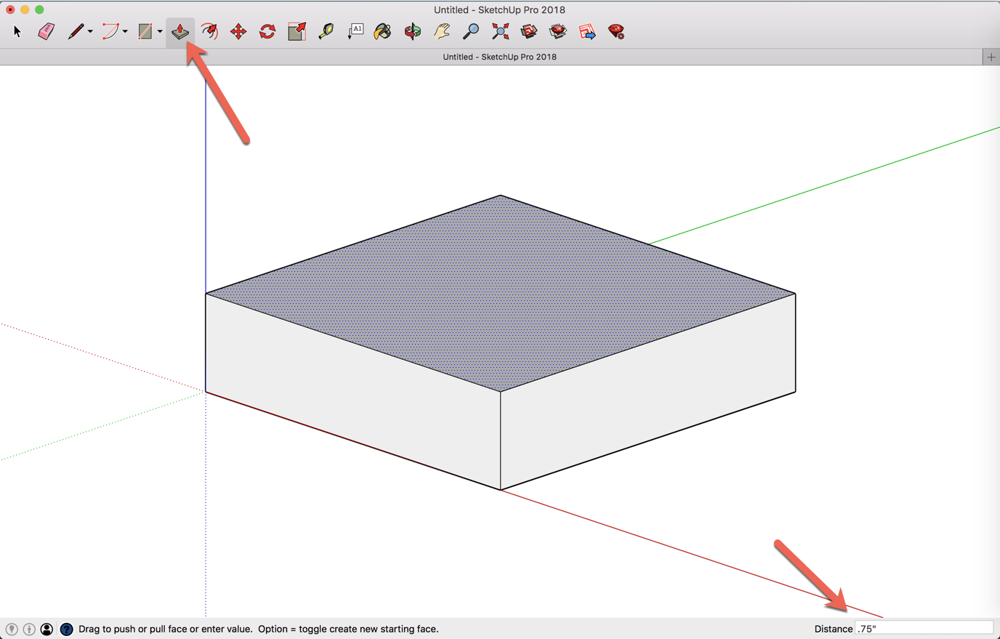
After your have made your base square you can use the extrude tool to create the shape
Select the extrude tool and draw your mouse up after selecting your shape
Type in .75”
Press enter
REMINDER: Your default view is zoomed far out

Slide 14
After your have made your base square you can use the extrude tool to create the shape
Select the extrude tool and draw your mouse up after selecting your shape
Type in .75”
Press enter
REMINDER: Your default view is zoomed far out

Slide 15
